Slide 1
GEOGRAPHICAL INFORMATION SYSTEM (GIS)
SCS3204
LECTURER 5
GIS FUNDAMENTALS
BY
Dr. Fredrick Kanobe (Ph.D)
Tel contact: 0782-592120 Emails: fkanobe@kyu.ac.ug or fred.Kanobe@gmail.com

Slide 2
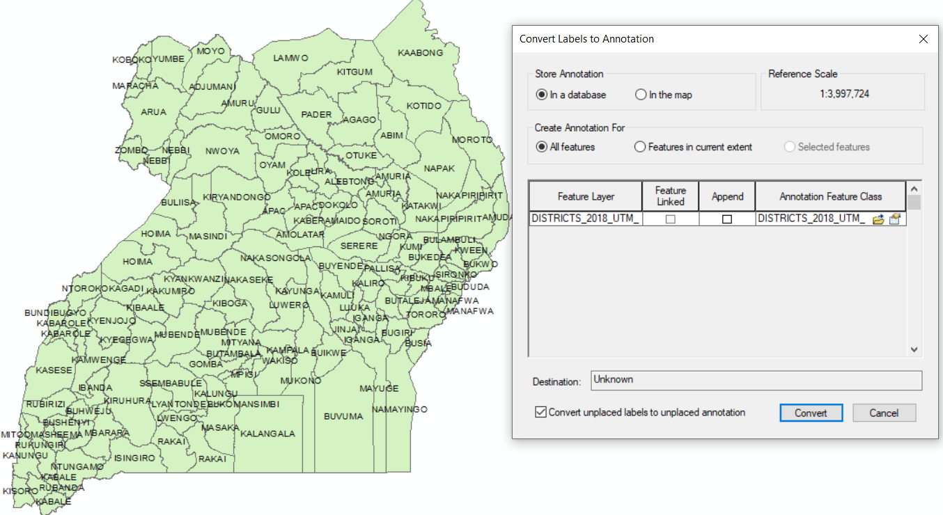
Moving Labels to Annotations
Converting labels to annotations is commonly used when one wants to relocate a label from one area to another. The labels can be either converted for the entire map layer, selected part of the layer or zoomed selected area.
Steps:
Right click the Layer in the table of contents containing the labels you want to convert
Select convert label to annotations
Select in the map option and features in the current extent
Click Convert
Click the Select elements icon
Click on the label you want to relocate and drag to new location

Slide 3
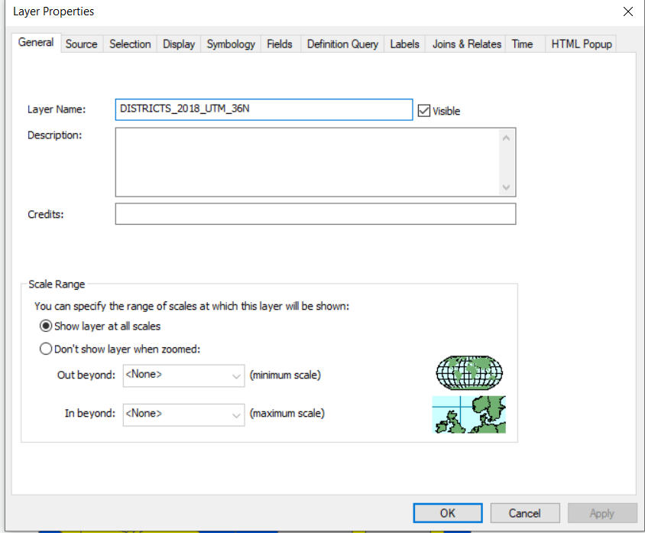
Renaming Map Layers Name
ArcMap permits users to rename the map layer without using the windows explorer. You can change the name of your map layer to the most appropriate name desired
Steps
Place the map layer you want to rename in the table of contents for example districts of Uganda
Right click the map layer in the ToC
Click properties
Click the General Tab
In the layer name, the current name is displayed
Type the new name you wand and click OK
General Tab
Type new name here

Slide 4
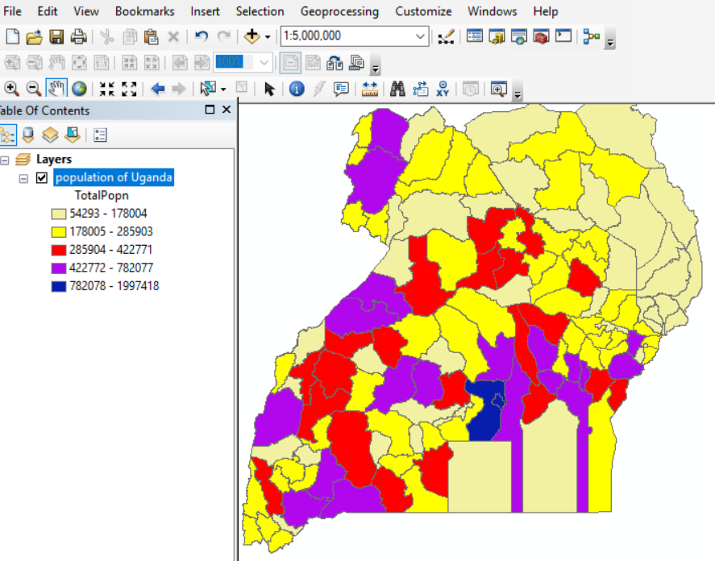
Creating a Map from Available Map Layers
You can create new map from available map layers in ArcMap. The most common maps designed using available layers include:
{1} Choropleth Map – It uses color polygon codes to convert information about an area. In a choropleth map, polygons are colored or shared to represent attribute values. We shall use the District map later to create choropleth map for population
Steps
Launch ArcMap
Add Uganda Districts in the TOC via catalog
Right Click your map layer (Uganda Districts) in the table of contents
Click Properties
Click General Tab
In the Layer’s name type population of Uganda to change the layer map from Districts
In the ToC Right Click Population of Uganda, Click Properties
Click Symbology Tab
In the Show Box Click Quantities and Graduated color
In the field box Click the value for Population
Select the Color Ramp
Click OK
Designed Map of Uganda showing Population

Slide 5
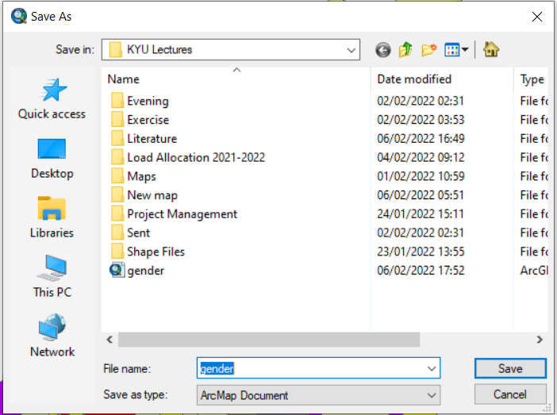
Saving your Choropleth Map
Once you have completed designing your map layer. It can be saved an independent and new map extracted from the mother layer.
Steps
Flick File on the Main menu
Select Save As
Browse and identify location where to save your Choropleth Map
Give it a new file name eg. Uganda districts by pop.
Click Save
Save As Options

Slide 6
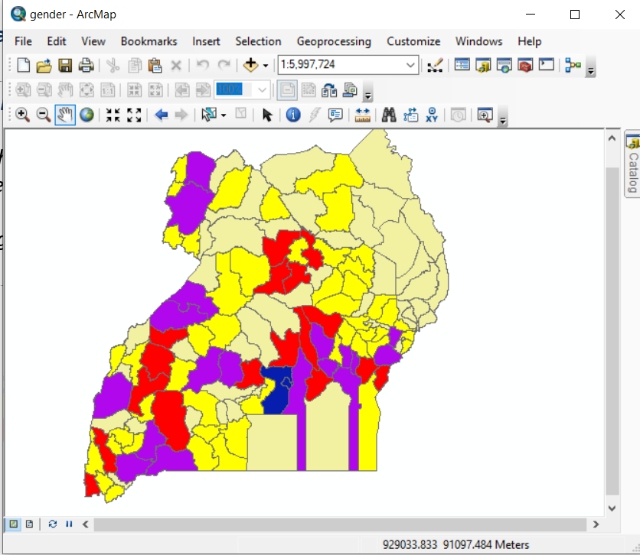
Illustration of some of the functions carried out in Attribute Table
Changing Map layer Scale
ArcMap users can change the scale of the existing layer in the simplest way by typing the new scale directly in the Scale text Bar
Place your map layer say Uganda Districts in the ToC
Type new Scale here

Slide 7
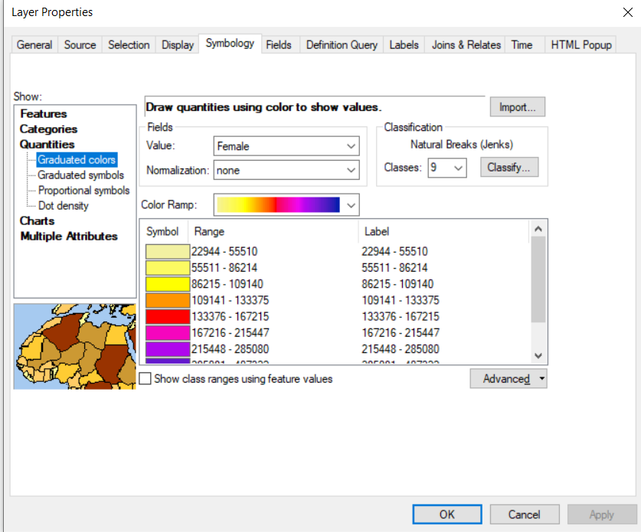
Creating Custom Classes in Legend
When you create a map layer, note that ArcMap automatically sets the legend using the default value in classification. In the previous new Choropleth map layer created, the default value was five. To set your custom classes in the legend, take the following steps:
Open your Choropleth Map previous designed (Population of Uganda) in the ToC
Right Click your Map layer in the ToC
Click Properties
Under Classification drop down menu select a value e.g. 9 then Click Apply and OK
Select Classification Value

Slide 8
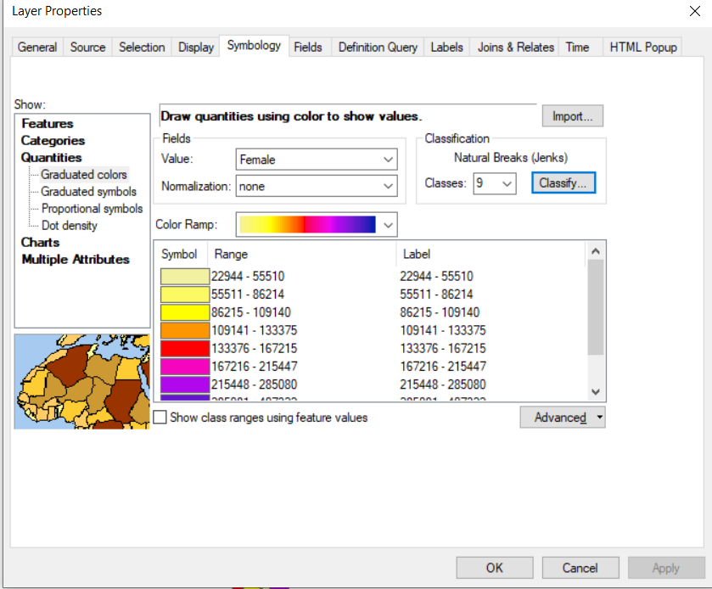
Displaying Descriptive statistics Using Classification
Users of ArcMap can as well display descriptive statistics of Geoata using the classification function
Steps
Open your Choropleth Map previous designed (Population of Uganda) in the ToC
Right Click your Map layer in the ToC
Click Properties
Under Classification drop down menu select a value
Click Classify
Click Classify

Slide 9
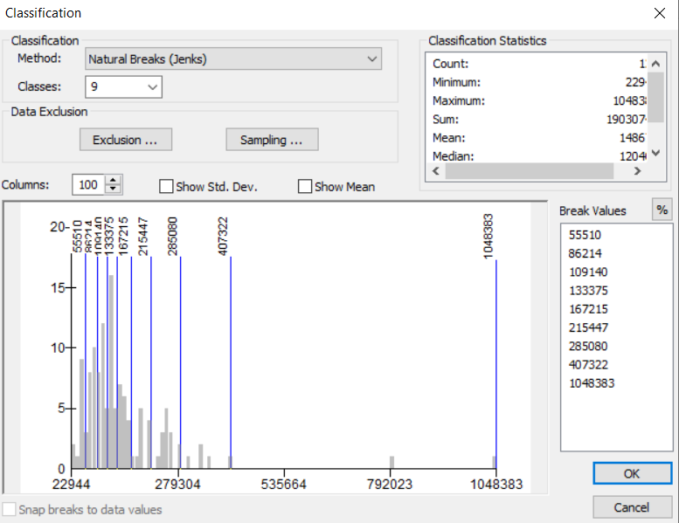
Illustration of Descriptive Statistics via Classification
Descriptive Statistics

Slide 10
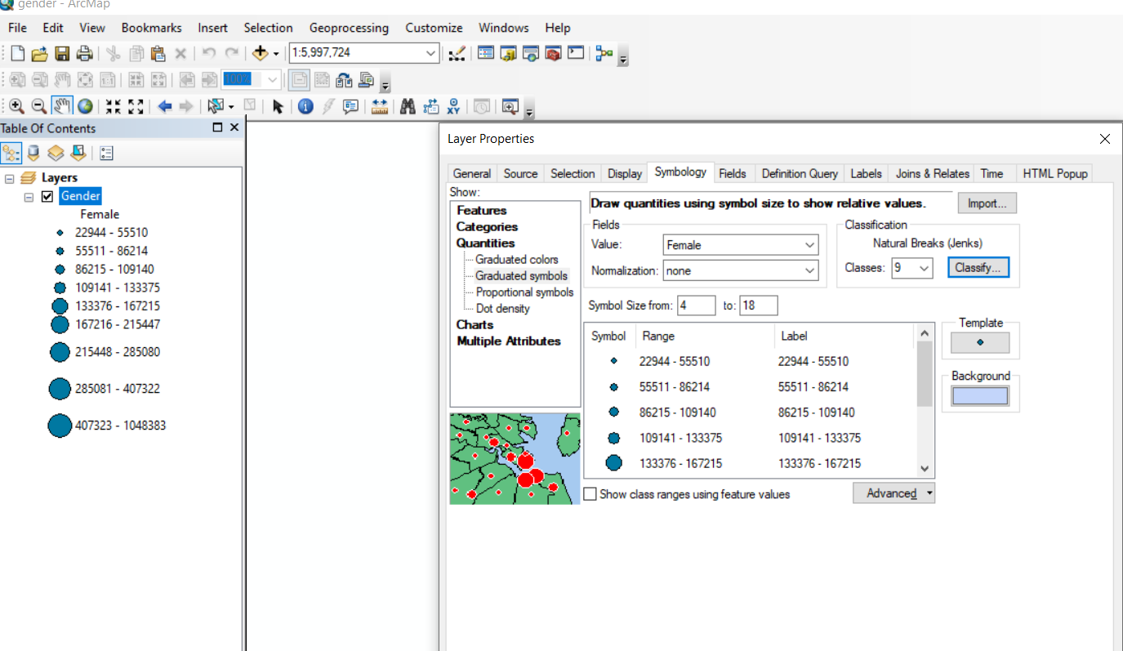
(2) Point Feature Maps – These use point markers to display spatial patterns in point data. To create point Map take the following steps:
Launch ArcMap
Add Uganda Districts in the TOC via catalog
Right Click your map layer (Uganda Districts) in the table of contents
Click Properties
Click General Tab
In the Layer’s name type population of Uganda to change the layer map from Districts
In the ToC Right Click Population of Uganda, Click Properties
Click Symbology Tab
In the Show Box Click Quantities and Graduated Symbols
In the field box Click the value for Population
Select the Color Ramp
Click OK
Select Graduated Symbols

Slide 11
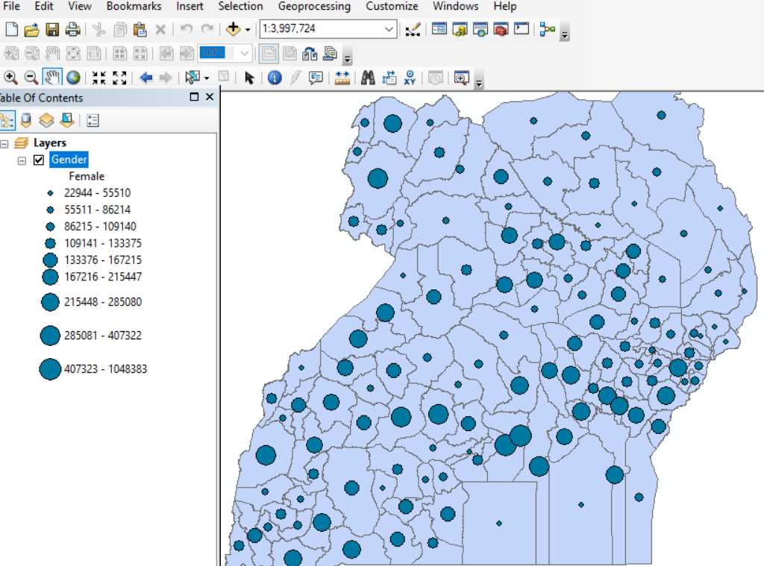
Illustration of Point Featured Map

Slide 12
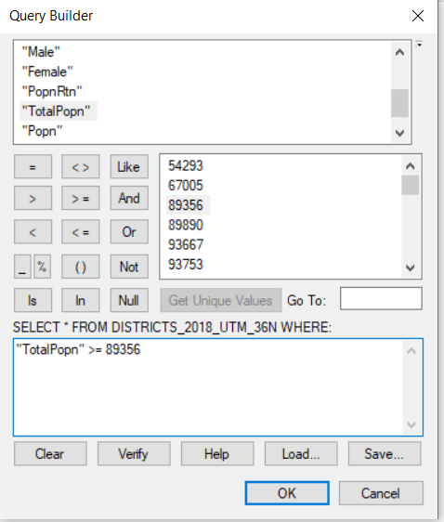
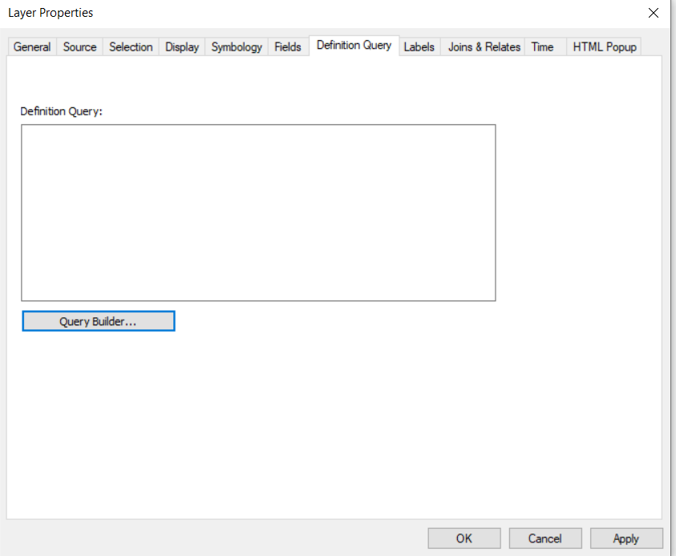
Creating Queries in ArcMap
Queries are used to determine which features a Map layer displays. Queries extra features to display based on the set parameters. In the District Map layer you may want to display only districts with total population less or equal to 80000
Steps
Place the district Map layer in the ToC
Right Click the district Map Layer in the table of contents
Click Properties
Click Definition Query Tab
Click Query builder
Double Click Totalpop
Select <= operator
Click Get Unique Values
Double Click the Value you want to use
Click Ok, Apply
Fields
Values
Operators
Definition Query Tab
Click Query Builder

Slide 13
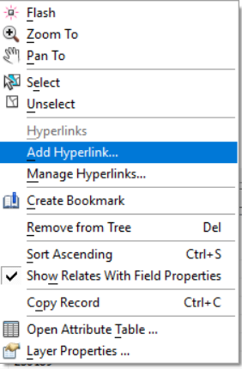
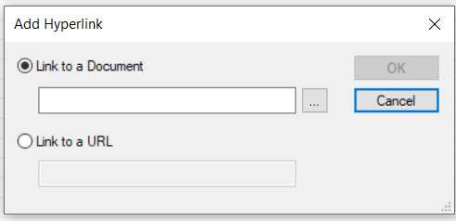
Creating Hyperlink
Hyperlink is commonly a button or text or image that points to another location. ArcMap allows users to create hyperlinks to other location such as websites. For example to create a hyperlink for Jinja district take the following steps
Place the Uganda District map layer in the ToC
On the tools toolbar click identify icon
Click on Jinja city
In the Identify window, Right Click Jinja City
Click Add Hyperlink
Select either to Document or URL
Browse the document to link or Type URL to be linked
Linking to Document
Linking to URL

Slide 14
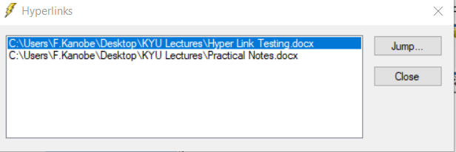
Launching Hyperlink
To open your created Hyperlink take the following steps”
On the Tools bar Click the Launch Hyperlink Button
Place the course in map layer feature where you created the Hyperlink and Click Once
Hyperlinked Documents

Slide 15
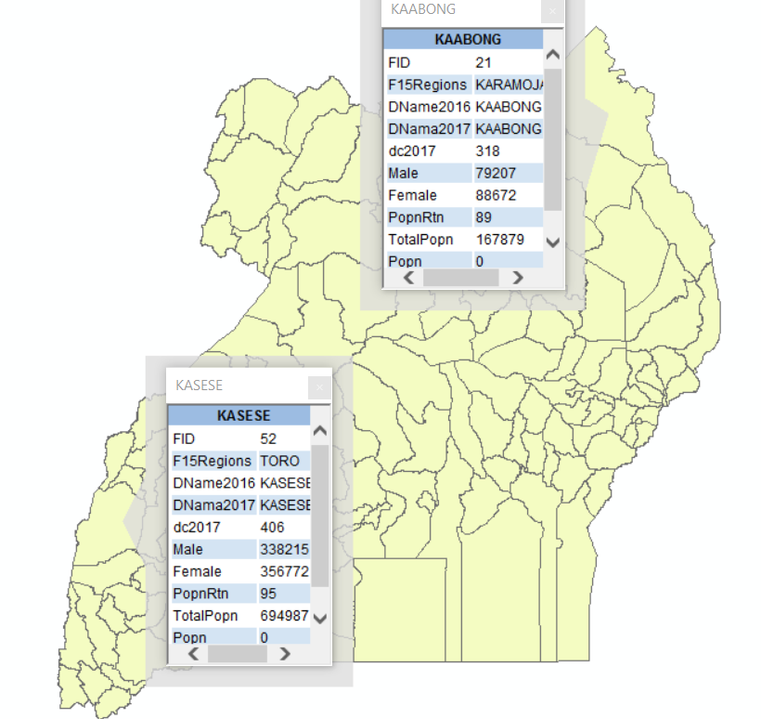
Creating Pop Up in ArcMap
Pop Ups are commonly used as short cuts for displaying attributes of features in a Map Lay. To create your Pop up for from the Uganda District Map Layer take the following steps:
Place the Uganda District Map layer in the ToC
Right Click the layer
Click Prosperities
Click the HTML popup
Make sure the following Boxes are checked √
Show content for this layer using HTML popup
As a table of the visible fields
Display coded value descriptions in all HTML
Click Apply and OK
Right Click the layer in the ToC
Click Prosperities
Click on the Fields Table and uncheck the fields you do not want to be visible , OK
On the Tools toolbar Click on the HTML popup icon
Move your cursor to any District of your choice and Click
Popups

Slide 16
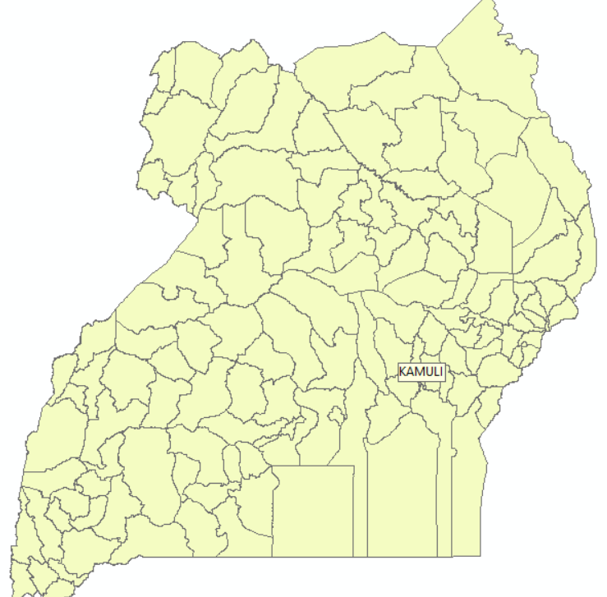
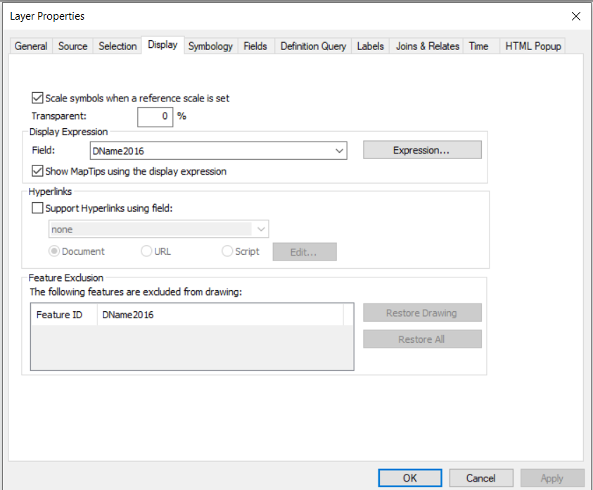
Creating Map Tips
Map tips are used for disclosing and displaying labels text for map layers in ArcMap. Once you have created the Map tips, any label for features in your map layer are displayed.
Steps
Place your District Map layer in the table of contents
Right Click the District Map layer
Click Properties‘
Click Display Tab
Check the Show the Map tips using display expression check Box
Click Ok
Move the features in your Map layer
Map tips

Slide 20


